Slide 1

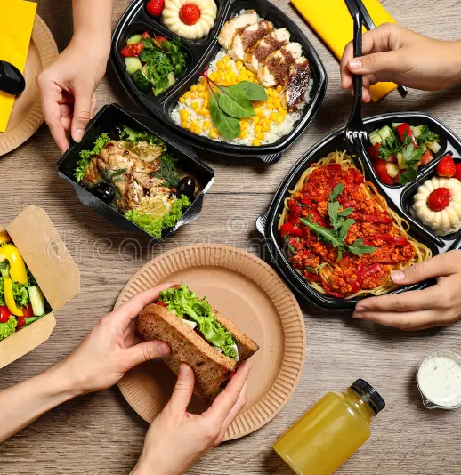
Amazon.
Food Delivery Analysis.

Slide 2
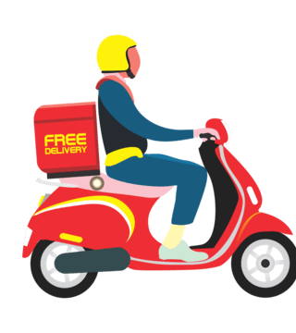
Table of contents.
1) Introduction.
2) Tools used to perform analysis
3) EDA
4) Feature engineering
5) Dashboard Overview
6) Delivery Person Performance
7) Pickup and delivery Analysis
8) Conclusion

Slide 3
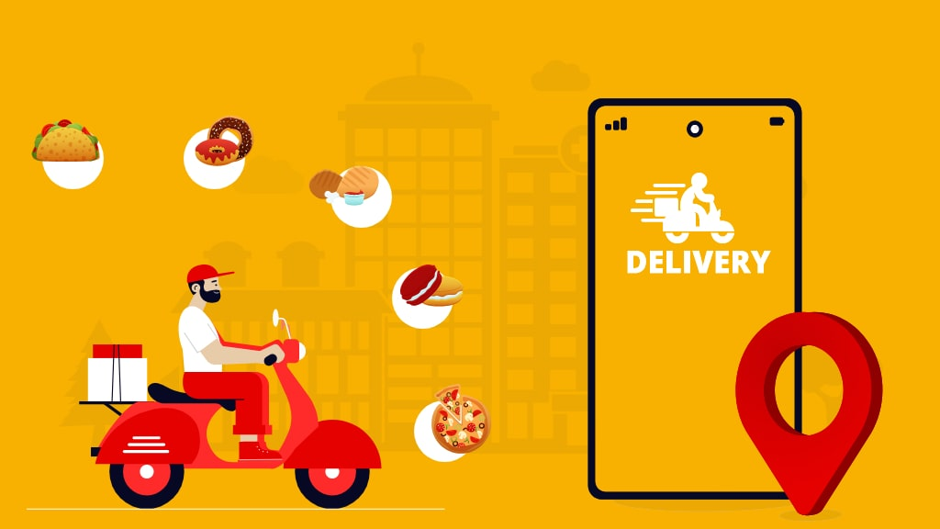
1.) Introduction.
The food delivery analysis project focuses on analyzing the delivery operation and customer feedback/experience. The tools that is used in this project is power bi, Visual studio code, Excel. The objective of this project mainly focuses on customer feedback and how to improve the experience in a better way.
The dataset contents information related to orders, restaurant distance, pickup time, delivery time, preparation time, Delivery partner rating, traffic density, climate etc.
The dashboard provides us insights about the order trends, delivery partner performance, pickup and delivery analysis. These insights will help us to identify the factors that needs to be focus on to improve our performance in a better way.

Slide 4



2). Tools used to perform analysis
Python- We have use python to clean data, detect outliers, one hot encoding, replace null values into median, EDA etc.
Excel- We have used excel to detect datatypes and set the datatype according to the data, remove unnecessary columns.
Power Bi- This tool used to analyze the performance of the delivery partner and the pickup drop analysis, this gives us meaningful insights with visual for better understanding. Additionally, we have calculated some DAX measure for better analysis.

Slide 5

3). Exploratory Data Analysis.
Total records are 11,399 rows and 20 columns.
Total null value in % is 1.1% and we removed those null values.
After removing null values total record is 10291 rows and 20 columns.
There was no duplicate values.
We have changed the datatype from object to float.
Replace the 0 values to median.

Slide 6
4). Feature Engineering.
Pickup time Take- This is the new column we added for the better analysis.
We have new measures calculated in power bi:
Average Age.
Average Rating
Maximum Rating
Minimum Rating
Multiple deliveries
Total Festival
Total orders.
We have converted festival column into 0 and 1 with the use of one hot encoding.
Detecting outliers with the help of IQR technique in python. As we discovered that the minimum value is 0, it is converted into median value to avoid bias. Restaurant latitude, longitude, delivery location latitude and longitude, these column were fixed.

Slide 7
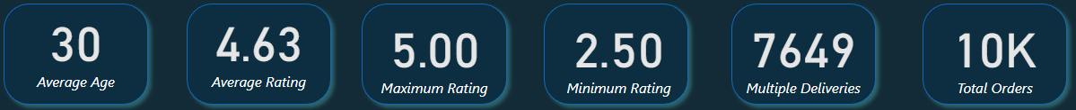
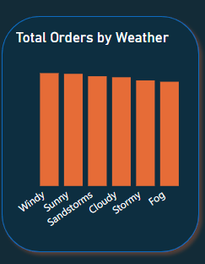
5).Dashboard Overview
As we can check in the figure. There are 5 KPI which shows average age, average rating, minimum rating, maximum rating, multiple deliveries, total orders.
Total orders in 10K. Average Rating is 4.7 which is good, minimum rating is 2.6 is low and needs to improve. Average age of a delivery partner is 30 which is good that means there are chances of multiple deliveries.
Total orders by weather:
Windy- total order is 1,746
Sunny - Total order is 1,735
Sandstrom- Total order is 1,698
Cloudy- Total order is 1,682
Storms- Total order is 1,633
Fog- Total order is 1,613

Slide 8
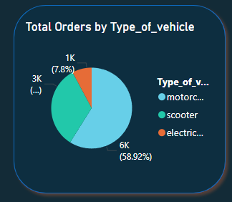
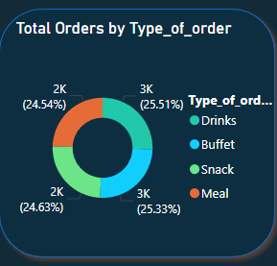
Dashboard Overview.
Total Orders by type of vehicle:
1) Motorcycle: Total orders in motorcycle is 5,955 (58.92%).
2) Scooter: Total orders delivered by scooter is 3,364 (33.28%).
3) Electric scooter: Total orders in electric scooter is 788 (7.8%).
Total type of orders:
1) Drinks: As per to the model drinks are the food type which is more sailable, which is 2,578 orders in total.
2) Buffet: Buffet is similar to the drinks but slight difference is there. The total order for buffet is 2,560 orders.
3) Snack: The total order for snake is 2,489 orders.
4) Meal: The total orders for meal is 2, 480.

Slide 9
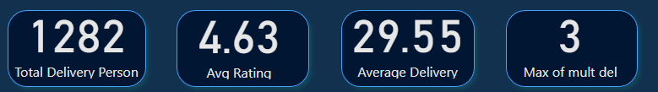
6). Delivery person performance.
KPI:
Total delivery person is 1,282
Average rating for them is 4.63% which is overall good.
Average delivery they do is 29.55 .
There are 3 multiple delivery on daily basis.
Here we have focus more on multiple deliveries and delivery rate on daily basis.
Average rating 4.63% is very good rating according to the model.

Slide 10
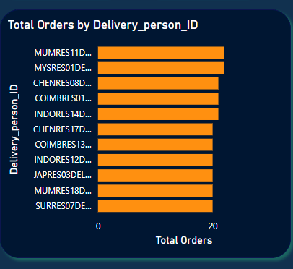
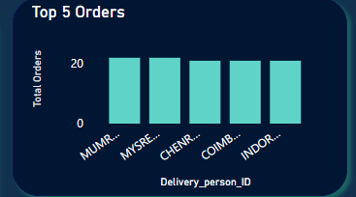
Total orders delivery and their top 5 orders.
There are top 5 delivery partners who is topping the chart by doing total 22 deliveries in a year.
Mumres11del02, mysres01del02, chenres08del01, coimbres01del01, indores14del01. These are the 5 ID who is topping the chart.
Mumres11del02- The location for this delivery partner is in Mumbai
Mysres01del02- This is located in Mysore.
Chenres08del01- This location is of Chennai
Indores14del01- This is from Indore.

Slide 11
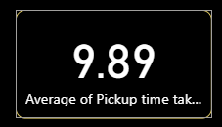
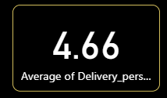
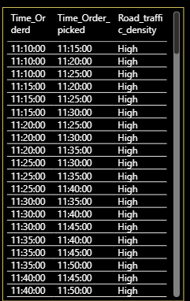
7). Pickup up and delivery analysis.
Road traffic density – HIGH
According to the analysis, if the road traffic density is high, the average time for pick up is more than 10 mins.
As we can check in the diagram, its taking 10 mins to pickup the order.
As we can check in the power bi there is no much difference in road traffic density. Timing is approx. 10 mins to pick up the delivery.
Average delivery partner rating is 4.6, which is good.

Slide 12
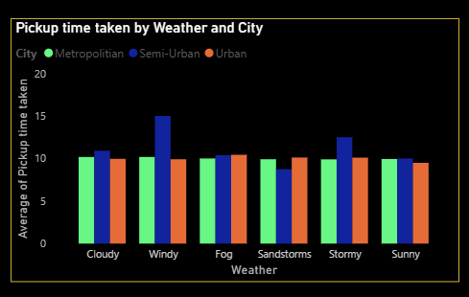
Pickup taken by weather and city.
If we check semi- urban cities there are high pickup time taken during windy and stormy weather.
In urban and metropolitan area there are approx. 10 mins taken to pickup the delivery which is fair.

Slide 13
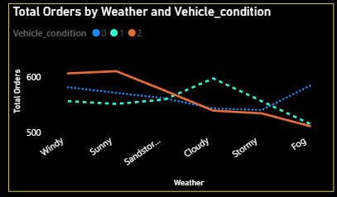
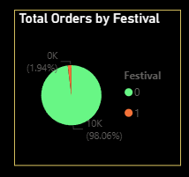
Total orders by weather and vehicle condition & Total order by festival.
If we see this chart during windy, sunny condition the vehicle condition is good. But during other weather condition the vehicle is not keeping that Great.
In this we can conclude that during sunny and windy we can take more orders and compare to others.
In 0 festival days there is more orders made as compare to festival days. We need to make sure that we take orders at non-festival days.

Slide 14
8). Conclusion.
1). The analysis indicate a high volume food delivery operation with strong customer rating, concentrated demand in metropolitan areas and motorcycle is a primary vehicle. Since order volumes remain stable across the weather conditions and other categories, the company can focus on optimizing delivery person performance, vehicle allocation, and operation in high-demand cities to improve efficiency further.
2). The delivery workforce demonstrates strong services quality and consistent performance. However, the average delivery time is 29 minutes and multiple order assignments suggested opportunities to pickup operations, workload distribution and improve delivery routes to further improve efficiency.
3). Optimizing the pickup operations during adverse weather especially in high demand cities could help to reduce in delays and improve overall delivery efficiency and customer experience.

